Slide 1
Securing Email using different techniques
Information Security Analysis and Audit

Slide 2
Project Members
MIHIR SRIVASTAVA(18BCI0214)
SHOURYA MAHESHWARI(18BCI0179)

Slide 3
TASKS
Open PGP
Key Pair Generation using OPENPGP Tool: Private and Public
Sharing the public key and the sender uses it to encrypt his mail
Decryption of the email using private key
Packet Capturing and checking whether message is encrypted or not
Creating a python application which is capable of sending email using SMTPLIB
Encrypting the channel through which the mail is sent
Usage of TLS to Encrypt the channel
Usage of SSL to Secure the communication
Using Packet Capturing tools to detect whether channel is secure or not

Slide 4
Abstract
Here we try to implement a custom email application using encryption techniques like ssl and tls, and an openpgp application using pretty good privacy itself and due to this when we try to intercept packets while sending the email, we find the packets to be encrypted.
Email encryption is encryption of email messages to protect the content from being read by entities other than the intended recipients. Email encryption may also include authentication. Email encryption can rely on public-key cryptography, in which users can each publish a public key that others can use to encrypt messages to them, while keeping secret a private key they can use to decrypt such messages or to digitally encrypt and sign messages they send.

Slide 5
methodology
Pretty Good Privacy (PGP)
is an encryption program that provides cryptographic privacy and authentication for data communication. PGP is used for signing, encrypting, and decrypting texts, e-mails, files, directories, and whole disk partitions and to increase the security of e-mail communications.
For encrypting email we will use openPGP tool. It is an open software which is free for public. With the help of this software one can encrypt a mail and decrypt a mail.
With the help of tool first we generate our key pair-Private Key and Public Key.
Then we will share our public key with people who want to send mail to us.
After receiving the mail from others we will try to decrypt using our private key.
This will help us to protect our mail from any attacker who try to see our mail.

Slide 6
Custom python email app
Python console emailer is a console (terminal) based python application that allows the user to sign in to their email and send emails to others using the email encryption type of their choice (SSL or TLS). The application allows the user to insert multiple text in the email via the command line (terminal).
The purpose of this project is to gain a greater understanding of how emails are created, encrypted, and sent. The application can be developed with the smtplib python module to emulate some of the functionality of the email python module.

Slide 7
Features of the custom app
Features
Choice of email encryption type (SSL or TLS)
Email sign-in
Specify display name
User is able to change the display name that they would show up as in the inbox of the recipient (default is [email_username])
Specify email subject
Sending multi-part email
Able to create multiple text email body sections

Slide 8
Purpose of our application
Here we use SSL and TLS for encryption
When you use a standard POP or IMAP connection to download your email (the most popular method still in use), your username and password is sent in cleartext across the Internet. This means that anyone using the same wireless connection as you, or the same network as you, or watching traffic at your ISP - or anyone in a position to see your Internet traffic can potentially "inctercept" your network traffic and clearly read your username and password. With this information, they can easily read all your email and worse, steal confidential information, send out spam or other malicious acts.

Slide 9
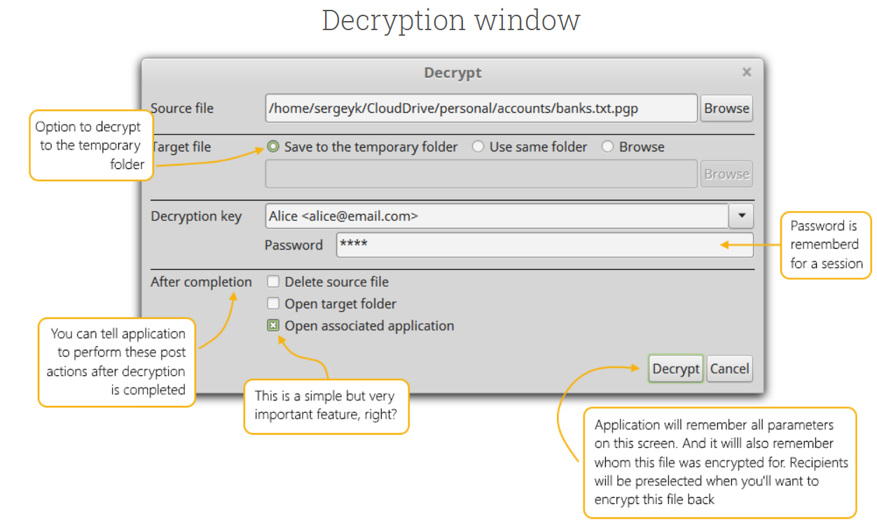
Tentative demo design

Slide 10
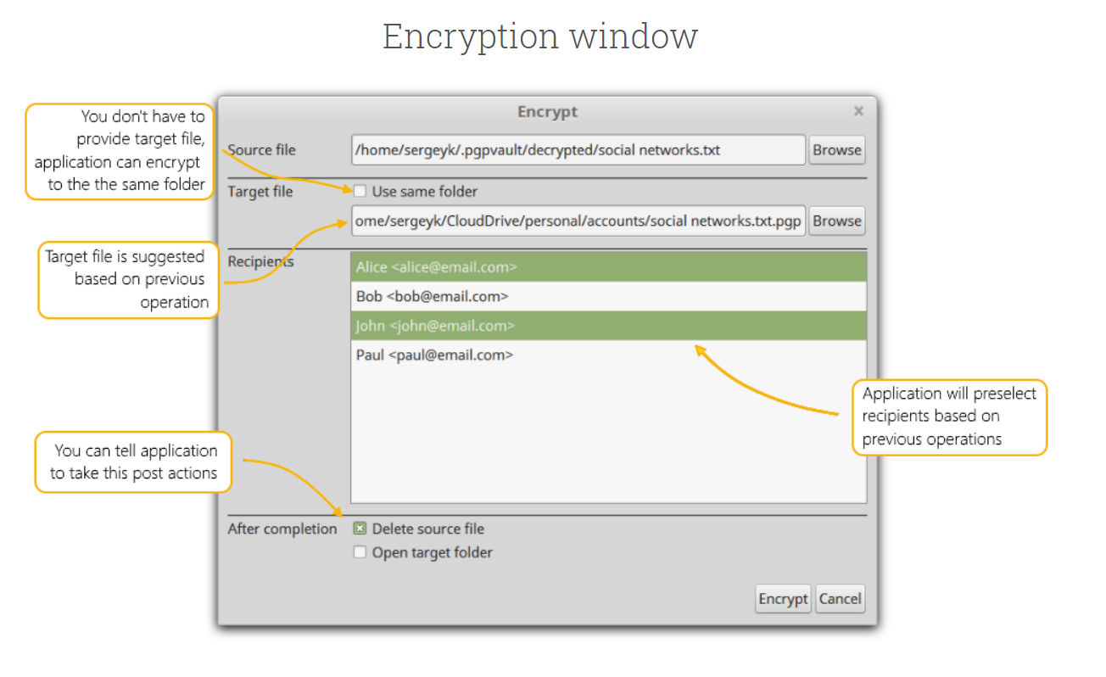
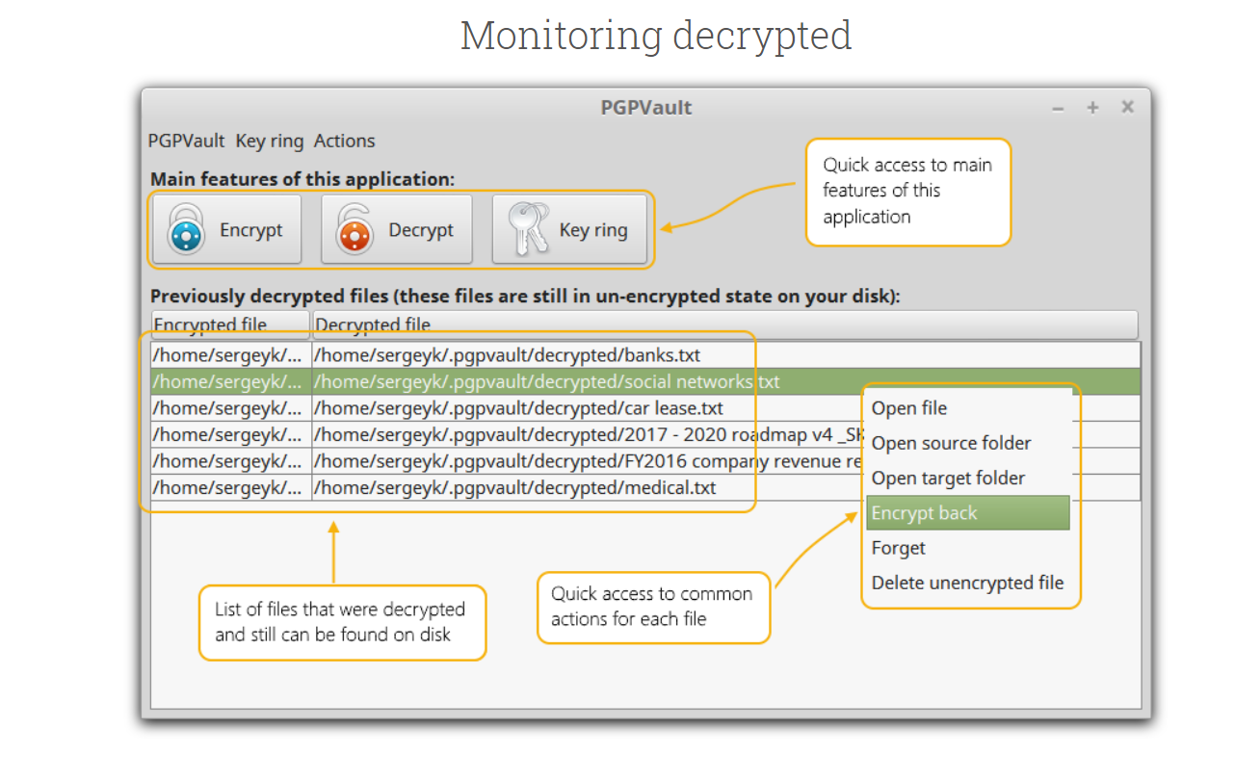

Slide 11
EXPECTED RESULT
In the open source Openpgp application with the help of tool first we generate our key pair-Private Key and Public Key.
Then we will share our public key with people who want to send mail to us.
After receiving the mail from others we will try to decrypt using our private key.
This will help us to protect our mail from any attacker who try to see our mail.
On the other hand the purpose of this custom email project is to gain a greater understanding of how emails are created, encrypted, and sent. The application can be developed with the smtplib python module to emulate some of the functionality of the email python module.

Slide 12
Tools used
OPENPGP
Python smtp console
Wireshark

Slide 13
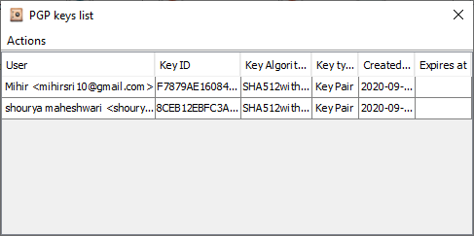
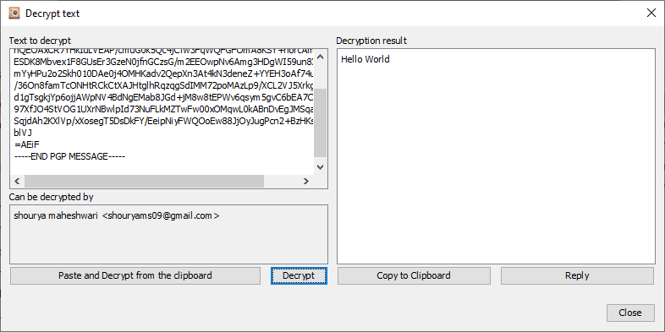
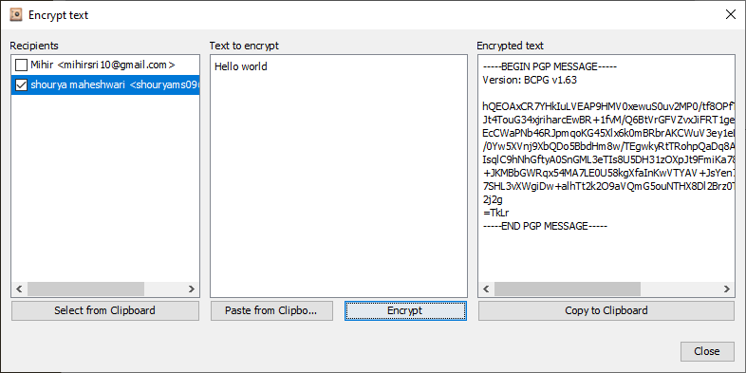
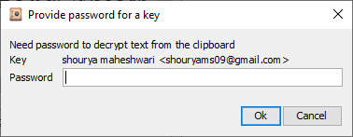

Slide 14
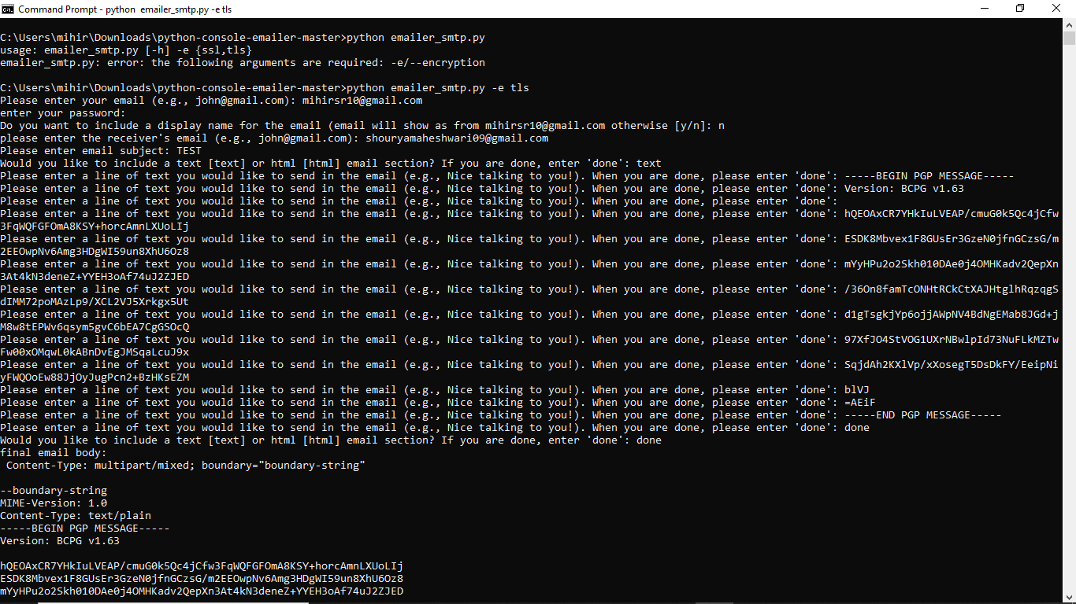

Slide 15
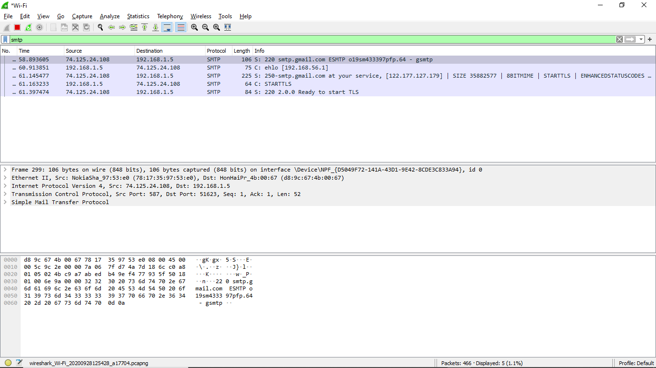

Slide 16
